Slide 1
Explain the CNN in detail

Slide 2
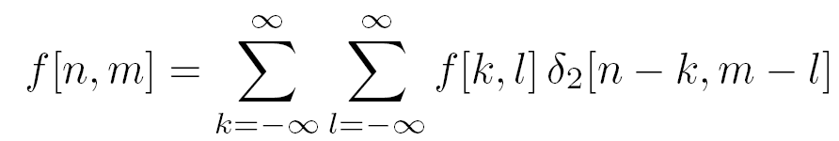
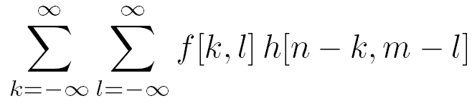
Recall convolutions…
12 | 3 | 19
25 | 10 | 1
9 | 7 | 17
1 | 2
3 | 4
? | ?
? | ?
*
=

Slide 3
Recall convolutions…
12 | 3 | 19
25 | 10 | 1
9 | 7 | 17
1 | 2
3 | 4
133 | ?
? | ?
*
=

Slide 4
Recall convolutions…
12 | 3 | 19
25 | 10 | 1
9 | 7 | 17
1 | 2
3 | 4
133 | 75
? | ?
*
=

Slide 5
Recall convolutions…
12 | 3 | 19
25 | 10 | 1
9 | 7 | 17
1 | 2
3 | 4
133 | 75
100 | ?
*
=

Slide 6
Recall convolutions…
12 | 3 | 19
25 | 10 | 1
9 | 7 | 17
1 | 2
3 | 4
133 | 75
100 | 101
*
=
Notes:
Equation

Slide 7
Recall convolutions…
12 | 3 | 19
25 | 10 | 1
9 | 7 | 17
1 | 2
3 | 4
133 | 75
100 | 101
*
=
Notes:
Equation

Slide 8
Recall convolutions…
12 | 21
18 | 31
1 | 2
3 | 4
?
*
=
Notes:
Equation

Slide 9
Recall convolutions…
12 | 21
18 | 31
1 | 2
3 | 4
232
*
=
Notes:
Equation

Slide 10
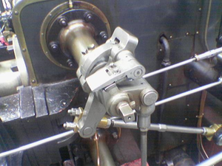
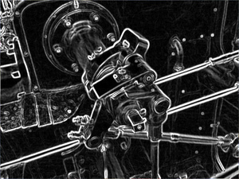
Why they are useful
Allow us to find interesting insights/features from images!
0 | -½ | 0
0 | 0 | 0
0 | ½ | 0
*
=

Slide 11
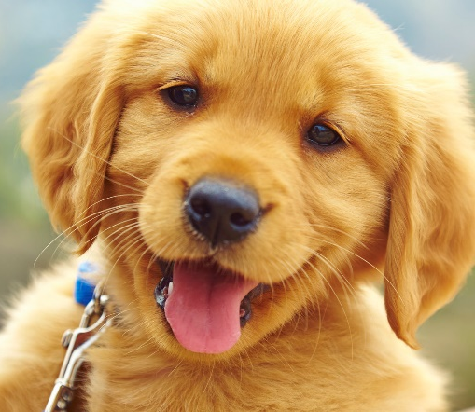
Recall Image Classification…
Featurizer
Classifier
“pupper”
Allow us to use features to put images in categories!

Slide 12

Wait a Minute…
Convolution = Image -> Features
Classification Algorithm = Features -> Category

Slide 13

Wait a Minute…
Convolution = Image -> Features
Classification Algorithm = Features -> Category
Let’s put ‘em together!

Slide 14
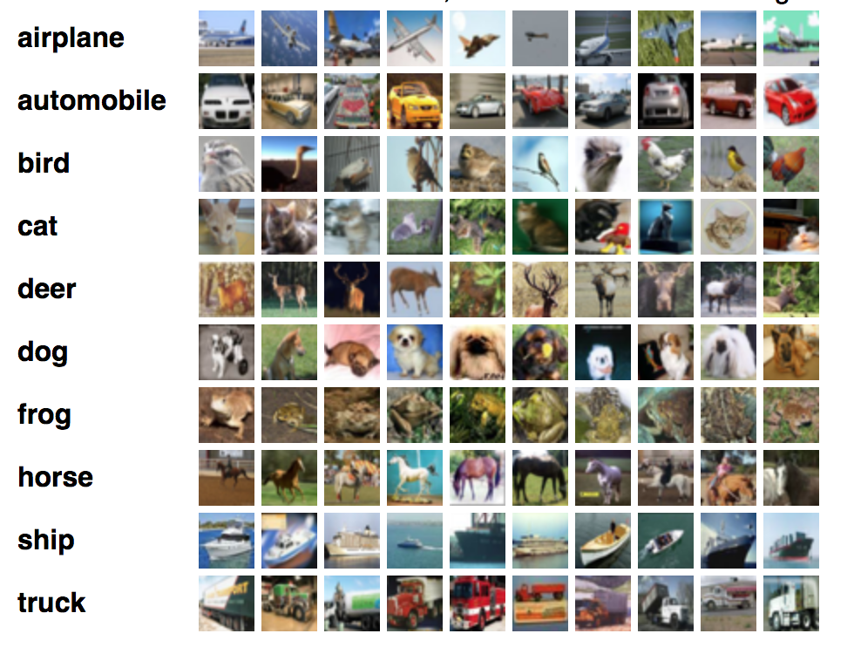
In Specific…
Let’s build a convolution-based classification algorithm for the
CIFAR-10 dataset (10 classes, 32x32 images):

Slide 15
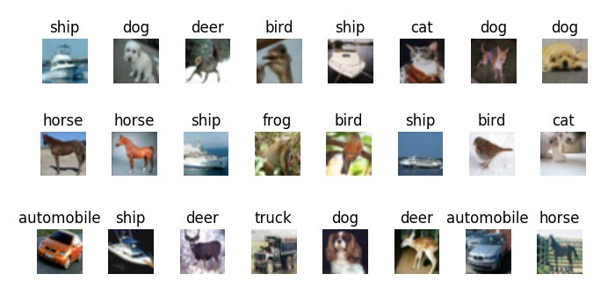
Feature Extractor
32x32 “Airplane Filter”
*
=

Slide 16
Feature Extractor
“probability” of the image being an airplane
32x32 “Airplane Filter”
*
=

Slide 17
Feature Extractor
“probability” of the image being an airplane
32x32 “Airplane Filter”
*
=

Slide 18
Feature Extractor
This is not really a probability but a score, because it can be less than 0 and greater than 1
“probability” of the image being an airplane
32x32 “Airplane Filter”
*
=

Slide 19
Feature Extractor
“probability” of the image being an automobile
32x32 “Automobile Filter”
*
=

Slide 20
Feature Extractor
“probability” of the image being a bird
32x32 “Bird Filter”
*
=

Slide 21
Feature Extractor
“probability” of the image being a truck
32x32 “Truck Filter”
*
=

Slide 22
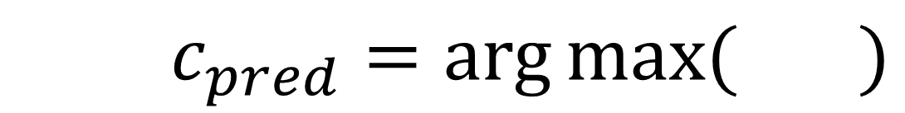
Classifier
$c_{pred}=\arg{\max{(} )}$

Slide 23
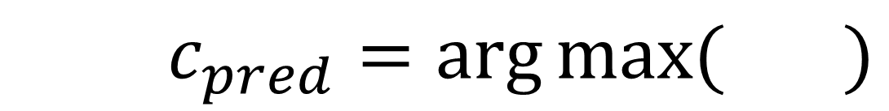
Classifier
$c_{pred}=\arg{\max{(} )}$
We predict the class that has the highest probability!

Slide 24



The Whole Shebang
32x32x10 Conv Block
$$argmax$$
$$c_{pred}$$
Feature Extractor
Prediction $\hat{y}$
Classification Output
Image
Classifier

Slide 25
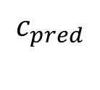
The Whole Shebang
32x32x10 Conv Block
$$argmax$$
$$c_{pred}$$
Feature Extractor
Prediction $\hat{y}$
Classification Output
Image
Classifier

Slide 26

The Whole Shebang
32x32x10 Conv Block
$$argmax$$
$$c_{pred}$$
Feature Extractor
Prediction $\hat{y}$
Classification Output
Image
Classifier

Slide 27
Reframing convolution
12 | 21
18 | 31
1 | 2
3 | 4
*
Notes:
Equation

Slide 28
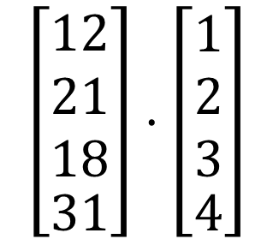
Reframing convolution
12 | 21
18 | 31
1 | 2
3 | 4
$$\left[\begin{matrix}\begin{aligned}12 \\ 21 \\ 18\end{aligned} \\ 31\end{matrix}\right]⋅\left[\begin{matrix}\begin{aligned}1 \\ 2 \\ 3\end{aligned} \\ 4\end{matrix}\right]$$
*
=
Notes:
Equation

Slide 29
Reframed Feature Extractor
32x32 “Airplane Filter”
*

Slide 30
Reframed Feature Extractor
Image
Vector
Airplane Weight Vector
32x32 “Airplane Filter”
.
*
=

Slide 31
New Feature Extractor
Image
Vector
Airplane Weight Vector
“probability” of the image being an airplane
.
=

Slide 32
New Feature Extractor
Image
Vector
Automobile Weight Vector
“probability” of the image being an automobile
.
=

Slide 33
New Feature Extractor
Image
Vector
Bird Weight Vector
“probability” of the image being a bird
.
=

Slide 34
New Feature Extractor
Image
Vector
Truck Weight Vector
“probability” of the image being a truck
.
=

Slide 35
New Feature Extractor
Weight Matrix
Image
Vector
X
=

Slide 36
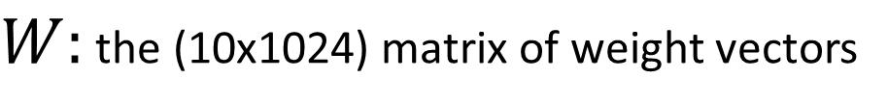

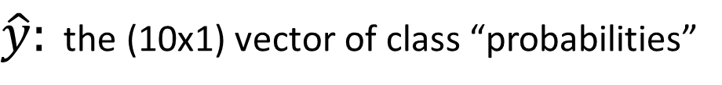
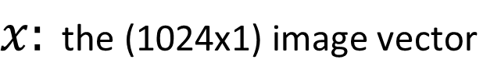
New Feature Extractor
$$Wx=\hat{y}$$
$W:$ the (10x1024) matrix of weight vectors
$x:$ the (1024x1) image vector
$\hat{y}:$ the (10x1) vector of class “probabilities”

Slide 37
New Feature Extractor
This simple computation is called a fully-connected layer!
$$Wx=\hat{y}$$
$W:$ the (10x1024) matrix of weight vectors
$x:$ the (1024x1) image vector
$\hat{y}:$ the (10x1) vector of class “probabilities”

Slide 38


Aside: Fully-Connected Neural Networks
Height
Algorithm
Dog
Width
Not Dog
Num_Legs
$$x$$
$$\hat{y}$$

Slide 39
Aside: Fully-Connected Neural Networks
Height
Dog
Width
Not Dog
Num_Legs
$$x$$
$$\hat{y}$$

Slide 40






Aside: Fully-Connected Neural Networks
Height
$$w_{1}$$
$$w_{4}$$
Dog
$$w_{2}$$
Width
$$w_{5}$$
$$w_{3}$$
Not Dog
$$w_{6}$$
Num_Legs
$$x$$
$$\hat{y}$$

Slide 41


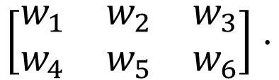



Aside: Fully-Connected Neural Networks
$$\left[\begin{matrix}w_{1} & w_{2} & w_{3} \\ w_{4} & w_{5} & w_{6}\end{matrix}\right]⋅$$
$$=$$
$$W$$
$$x$$
$$\hat{y}$$
$$Wx=\hat{y}$$

Slide 42
Aside: Fully-Connected Neural Networks
”Fully-Connected”
”Neural Network”
Every node is connected to every other node
Kinda looks like a neuron!

Slide 43
New Feature Extractor
$$Wx=\hat{y}$$
$W:$ the (10x1024) matrix of weight vectors
$x:$ the (1024x1) image vector
$\hat{y}:$ the (10x1) vector of class “probabilities”

Slide 44
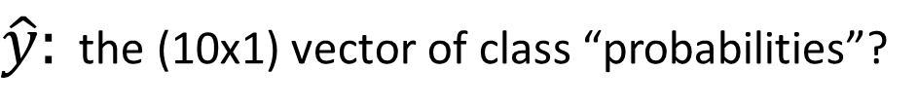
New Feature Extractor
$$Wx=\hat{y}$$
$W:$ the (10x1024) matrix of weight vectors
$x:$ the (1024x1) image vector
$\hat{y}:$ the (10x1) vector of class “probabilities”?

Slide 45

Class Probability Vector
Must have values between 0 and 1
Must sum to 1
There’s no guarantee either requirement is satisfied!
$$\hat{y}=Wx$$

Slide 46
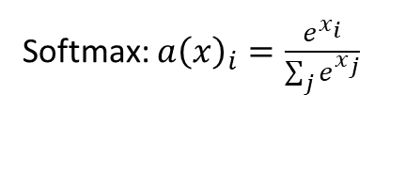

Softmax Function
$$a$$
1
-3
Softmax: $a{\left(x\right)}_{i}=\frac{e^{x_{i}}}{\sum_{j}{e^{x_{j}}}}$

Slide 47

Softmax Function
$$a$$
$$SM(a)$$
1
0.98
-3
0.02
Softmax: $a{\left(x\right)}_{i}=\frac{e^{x_{i}}}{\sum_{j}{e^{x_{j}}}}$

Slide 48
Class Probability Vector
Must have values between 0 and 1
Must sum to 1
$$\hat{y}=Wx$$

Slide 49

Class Probability Vector
Must have values between 0 and 1
Must sum to 1
$$\hat{y}=SM(Wx)$$

Slide 50


System so far…
Feature extractor:
Classifier:
$$\hat{y}=SM(Wx)$$
$$c_{pred}=\arg{\max{(\hat{y})}}$$

Slide 51
System so far…
Feature extractor:
Classifier:
$$\hat{y}=SM(Wx)$$
$$c_{pred}=\arg{\max{(\hat{y})}}$$

Slide 52
System so far…
Feature extractor:
Classifier:
$$\hat{y}=SM(Wx)$$
$$c_{pred}=\arg{\max{(\hat{y})}}$$

Slide 53


Using the label
Let’s compare our prediction with the real answer! For each image, we have the label $y$ which tells us the true class:
y
X
$$\left[\begin{matrix}\begin{aligned}0 \\ 0 \\ 0 \\ 0 \\ 0 \\ 1 \\ 0 \\ 0 \\ 0\end{aligned} \\ 0\end{matrix}\right]$$
Dog class index

Slide 54

Key Insight:
We want:
$$\arg{\max\left(\hat{y}\right)}=\arg{\max\left(y\right)}$$

Slide 55
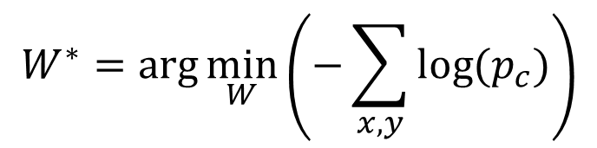
Key Insight:
We want:
$$\arg{\max\left(\hat{y}\right)}=\arg{\max\left(y\right)}$$
Which we can accomplish by:
$$W^{∗}=\arg{\min_{W}\left(−\sum_{x,y}{log⁡(p_{c})}\right)}$$

Slide 56
Key Insight:
We want:
$$\arg{\max\left(\hat{y}\right)}=\arg{\max\left(y\right)}$$
Which we can accomplish by:
$$W^{∗}=\arg{\min_{W}\left(−\sum_{x,y}{log⁡(p_{c})}\right)}$$
Where $p_{c}$ is the probability of the true class in $\hat{y}$

Slide 57

Cross-Entropy Loss
Our loss function represents how bad we are currently doing:
$$L=−log⁡(p_{c})$$

Slide 58
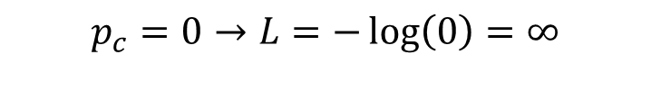
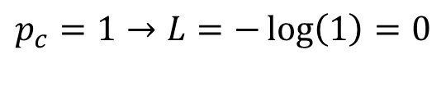
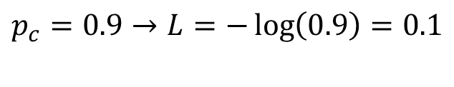

Cross-Entropy Loss
Our loss function represents how bad we are currently doing:
$$L=−log⁡(p_{c})$$
Examples:
$$p_{c}=0→L=−\log\left(0\right)=∞$$
$$p_{c}=0.1→L=−\log\left(0.1\right)=2.3$$
$$p_{c}=0.9→L=−\log\left(0.9\right)=0.1$$
$$p_{c}=1→L=−\log\left(1\right)=0$$

Slide 59
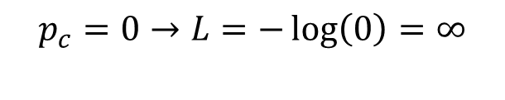
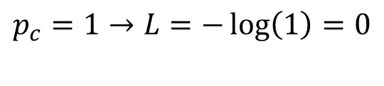
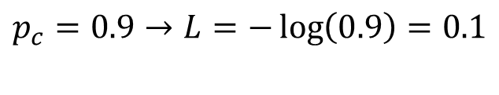

Cross-Entropy Loss
Our loss function represents how bad we are currently doing:
$$L=−log⁡(p_{c})$$
Examples:
$$p_{c}=0→L=−\log\left(0\right)=∞$$
The larger the loss, the worse our prediction. We want to minimize L!
$$p_{c}=0.1→L=−\log\left(0.1\right)=2.3$$
$$p_{c}=0.9→L=−\log\left(0.9\right)=0.1$$
$$p_{c}=1→L=−\log\left(1\right)=0$$

Slide 60


Minimizing Loss
$$L$$
$$w$$

Slide 61
Minimizing Loss
$$L$$
$$w$$

Slide 62
Minimizing Loss
$$L$$
$$w$$

Slide 63
Minimizing Loss
$$L$$
$$w$$

Slide 64
Minimizing Loss
$$L$$
$$w$$

Slide 65
Minimizing Loss
$$L$$
$$w$$

Slide 66
Minimizing Loss
$$L$$
$$w$$

Slide 67
Minimizing Loss
$$L$$
$$w$$

Slide 68
Minimizing Loss
$$L$$
GRADIENT DESCENT!
$$w$$

Slide 69
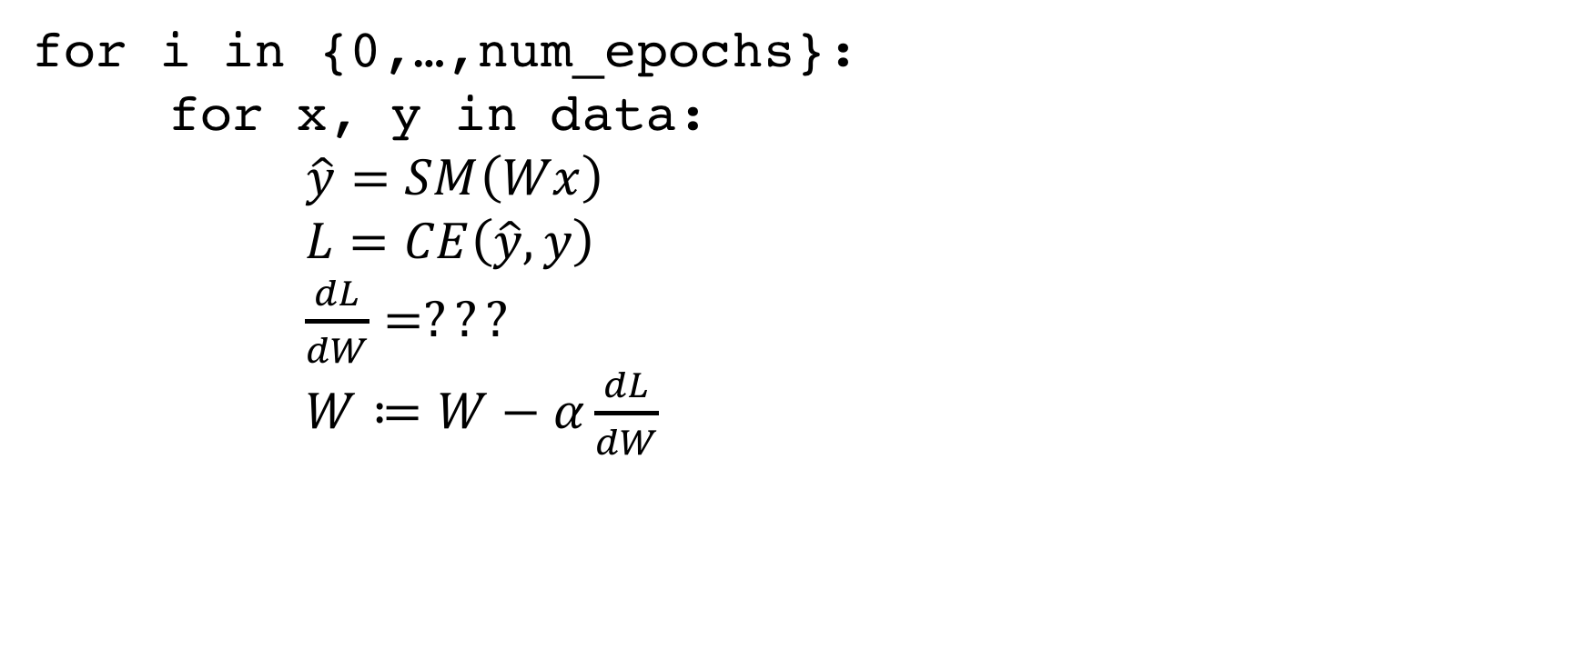
Gradient Descent Pseudocode
for i in {0,…,num_epochs}:
for x, y in data:
$\hat{y}=SM\left(Wx\right)$
$L=CE\left(\hat{y},y\right)$
$\frac{dL}{dW}=???$
$W≔W−α\frac{dL}{dW}$

Slide 70
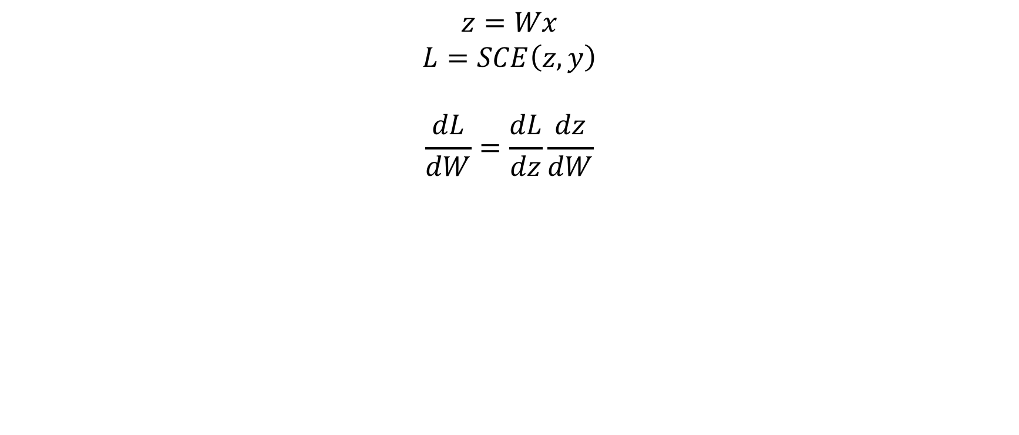
Getting the Gradient
$$z=Wx$$
$$L=SCE\left(z, y\right)$$
$$\frac{dL}{dW}=\frac{dL}{dz}\frac{dz}{dW}$$

Slide 71
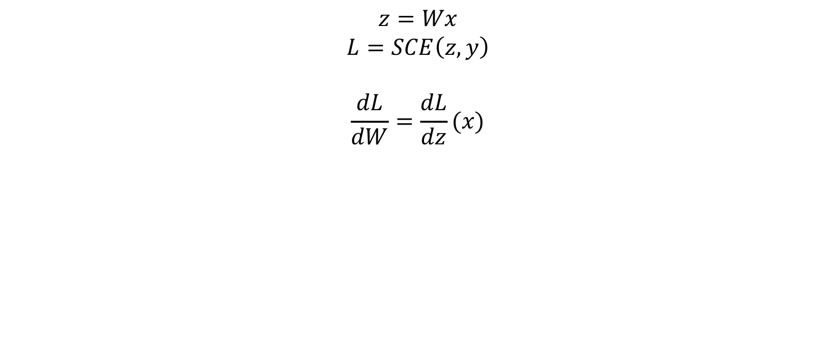
Getting the Gradient
$$z=Wx$$
$$L=SCE\left(z, y\right)$$
$$\frac{dL}{dW}=\frac{dL}{dz}(x)$$

Slide 72
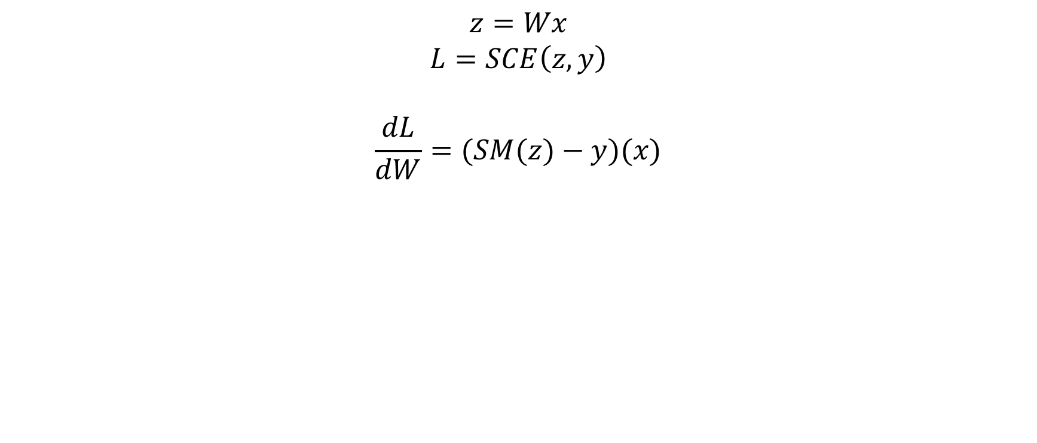
Getting the Gradient
$$z=Wx$$
$$L=SCE\left(z, y\right)$$
$$\frac{dL}{dW}=(SM(z)−y)(x)$$

Slide 73
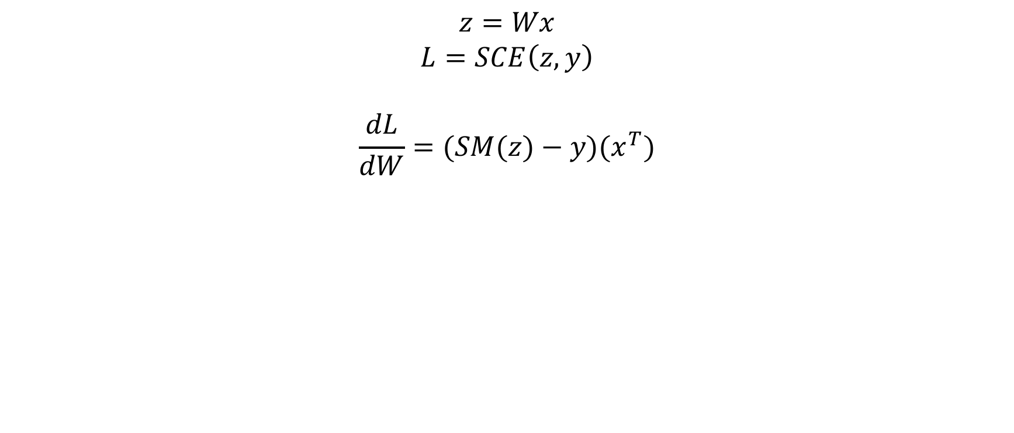
Getting the Gradient
$$z=Wx$$
$$L=SCE\left(z, y\right)$$
$$\frac{dL}{dW}=(SM(z)−y)(x^{T})$$

Slide 74
Getting the Gradient
$$z=Wx$$
$$L=SCE\left(z, y\right)$$
$$\frac{dL}{dW}=(SM(z)−y)(x^{T})$$
BACKPROPAGATION!

Slide 75







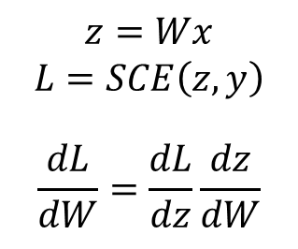
What is Backprop?
$$z=Wx$$
$$L=SCE\left(z, y\right)$$
$$\frac{dL}{dW}=\frac{dL}{dz}\frac{dz}{dW}$$
$$W$$
$$×$$
$$z$$
$$x$$
$$SCE$$
$$L$$
$$y$$

Slide 76


What is Backprop?
$$z=Wx$$
$$L=SCE\left(z, y\right)$$
$$\frac{dL}{dW}=\frac{dL}{dz}\frac{dz}{dW}$$
$$W$$
$$×$$
$$z$$
$$\frac{dz}{dW}$$
$$x$$
$$\frac{dL}{dz}$$
$$SCE$$
$$L$$
$$y$$

Slide 77


What is Backprop?
$$z=Wx$$
$$L=SCE\left(z, y\right)$$
$$\frac{dL}{dW}=\frac{dL}{dz}\frac{dz}{dW}$$
$$W$$
$$×$$
$$z$$
$${\frac{dz}{dW} =x}^{T}$$
$$x$$
$$\frac{dL}{dz}=SM(z)−y$$
$$SCE$$
$$L$$
$$y$$

Slide 78
What is Backprop?
$$z=Wx$$
$$L=SCE\left(z, y\right)$$
$$\frac{dL}{dW}=\frac{dL}{dz}\frac{dz}{dW}$$
$$W$$
$$×$$
$$z$$
$${\frac{dz}{dW} =x}^{T}$$
$$x$$
$$\frac{dL}{dz}=SM(z)−y$$
$$SCE$$
$$L$$
When computations are treated as nodes, all derivatives depend only on inputs to that node.
$$y$$

Slide 79
What is Backprop?
cache_{X} = {x}
$$z=Wx$$
$$L=SCE\left(z, y\right)$$
$$\frac{dL}{dW}=\frac{dL}{dz}\frac{dz}{dW}$$
$$W$$
$$×$$
$$z$$
$${\frac{dz}{dW} =x}^{T}$$
cache_{SCE} = {z, y}
$$x$$
$$\frac{dL}{dz}=SM(z)−y$$
$$SCE$$
$$L$$
When computations are treated as nodes, all derivatives depend only on inputs to that node.
$$y$$
So, we can cache the initial computation and reuse!

Slide 80
Backprop-Friendly Code
class FullyConnected:
def __init__(self):
self.cache = {}
def forward(self, W, x):
self.cache[‘x’] = x
return np.dot(W, x)
def backward(self, dout):
x = self.cache[‘x’]
return np.matmul(dout, x.T)
class SCELoss:
def __init__(self):
self.cache = {}
def forward(self, z, y):
self.cache[‘z’] = z
self.cache[‘y’] = y
return sce(z, y)
def backward(self):
z = self.cache[‘z’] y = self.cache[‘y’]
return sm(z) - y

Slide 81
Gradient Descent Pseudocode (Updated)
for i in {0,…,num_epochs}:
for x, y in data:
$\hat{y}=SM\left(Wx\right)$
$L=CE\left(\hat{y},y\right)$
$\frac{dL}{dW}=???$
$W≔W−α\frac{dL}{dW}$

Slide 82
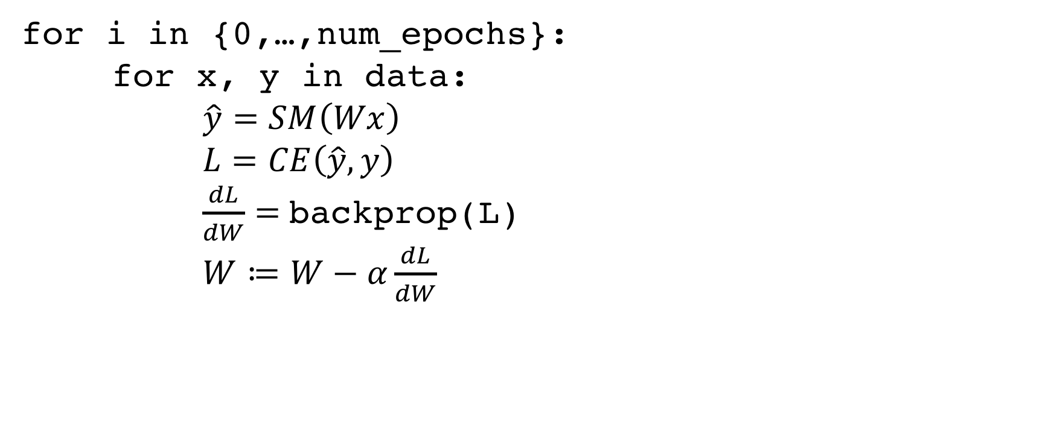
Gradient Descent Pseudocode (Updated)
for i in {0,…,num_epochs}:
for x, y in data:
$\hat{y}=SM\left(Wx\right)$
$L=CE\left(\hat{y},y\right)$
$\frac{dL}{dW}=$ backprop(L)
$W≔W−α\frac{dL}{dW}$

Slide 83
Gradient Descent Pseudocode (Updated)
for i in {0,…,num_epochs}:
for x, y in data:
$\hat{y}=SM\left(Wx\right)$
$L=CE\left(\hat{y},y\right)$
$\frac{dL}{dW}=$ backprop(L)
$W≔W−α\frac{dL}{dW}$
MACHINE LEARNING!

Slide 84
Our Classification System
32x32x10 Conv Block
$$argmax$$
$$c_{pred}$$
Feature Extractor
Prediction $\hat{y}$
Classification Output
Image
Classifier

Slide 85






Our Classification System (modified)
32x32x10 Conv Block
$$argmax$$
$$c_{pred}$$
Input Image
Feature Extractor
Prediction $\hat{y}$
Classifier
Classification Output
$$y$$
$$CE$$
$$L$$
Input Label
Loss Function
Loss Value

Slide 86
Our Classification System (modified)
32x32x10 Conv Block
$$argmax$$
$$c_{pred}$$
Input Image
Feature Extractor
Prediction $\hat{y}$
Classifier
Classification Output
1) Minimize this…
$$y$$
$$CE$$
$$L$$
Input Label
Loss Function
Loss Value

Slide 87
Our Classification System (modified)
32x32x10 Conv Block
$$argmax$$
$$c_{pred}$$
Input Image
Feature Extractor
Prediction $\hat{y}$
Classifier
Classification Output
2) By modifying this…
1) Minimize this…
$$y$$
$$CE$$
$$L$$
Input Label
Loss Function
Loss Value

Slide 88
Our Classification System (modified)
32x32x10 Conv Block
$$argmax$$
$$c_{pred}$$
Input Image
Feature Extractor
Prediction $\hat{y}$
Classifier
Classification Output
2) By modifying this…
1) Minimize this…
$$y$$
$$CE$$
$$L$$
Input Label
Loss Function
Loss Value
3) Using gradient descent!

Slide 89
Our Classification System (modified)
32x32x10 Conv Block
$$argmax$$
$$c_{pred}$$
BUT DOES IT WORK?
Input Image
Feature Extractor
Prediction $\hat{y}$
Classifier
Classification Output
2) By modifying this…
1) Minimize this…
$$y$$
$$CE$$
$$L$$
Input Label
Loss Function
Loss Value
3) Using gradient descent!

Slide 90
Our System’s Performance
~40% accuracy on CIFAR-10 test
Best class: Truck (~60%)
Worst class: Horse (~16%)
Check out the model at: https://tinyurl.com/cifar10
What about the filters? What do they look like?

Slide 91
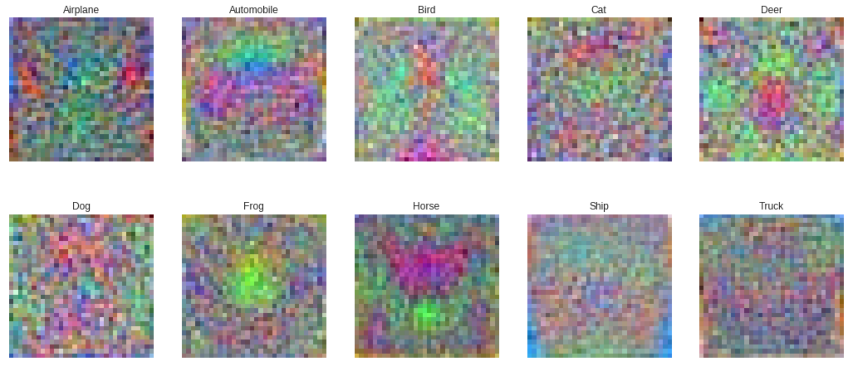
Visualizing the Filters

